Slide 1
Mission and Vision
Operating Model
Financial Highlights
Community Involvements
Future Plan and Strategies
The HKICPA Accounting and Business Management Case Competition 2019-20

Slide 2
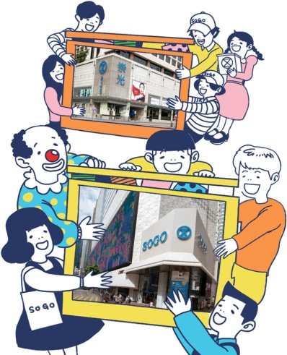
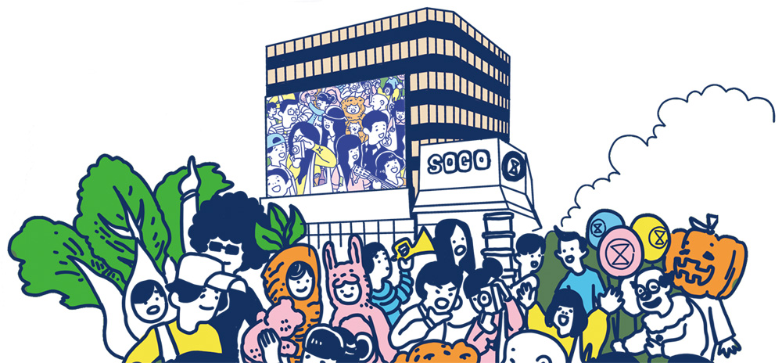
Mission and Vision
To be the leading department store operator in Hong Kong
Provide our customers with goods and services of finest quality

Slide 3
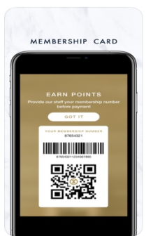
Operating Model
1) Distinctive Characteristics
Business model: Department store – “Shops-in-shop”
Strong brand equity and customer loyalty
Close relationship with brands
Whole store promotion and festival events (e.g. Thankful Week, Christmas, etc.)
Central cashier arrangement
Customer loyalty program – SOGO Rewards

Slide 4
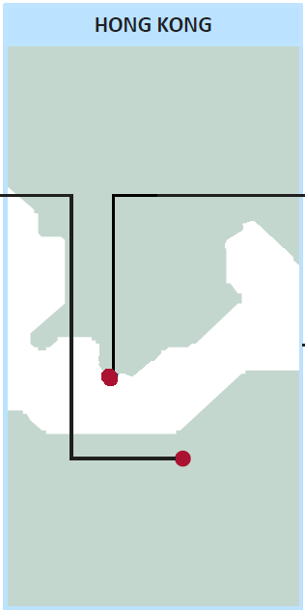
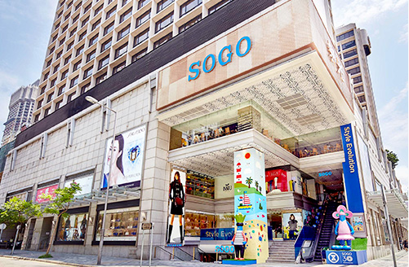
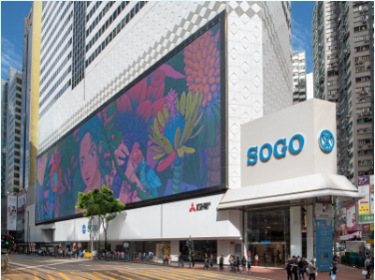
Operating Model
2) Property ownership and un-paralleled location
SOGO CWB
Opened since May 1985 Flagship store Property ownership: 100% Comprehensive product offerings ranging from luxury brands, fashion, cosmetics, watches and jewelries, accessories, home appliances to food and beverages
Tsim Sha Tsui
(“TST”)
SOGO TST
New SOGO TST opened since Nov 2014 Property ownership: leased Product offerings include fashion, cosmetics, watches and jewelries
Causeway Bay
(“CWB”)

Slide 5
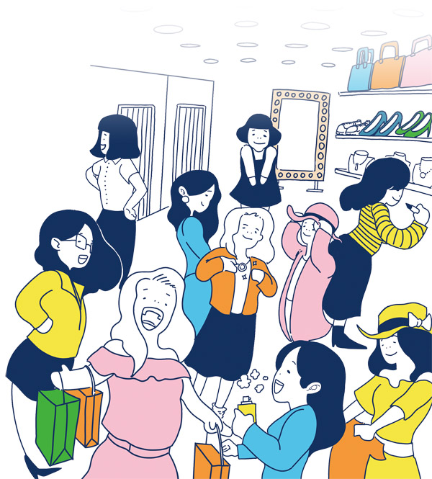
Operating Model
3) Product and counter management
Direct
Consignment
Source and sell own merchandise
Counters managed by our own staff
Pay to vendors when the goods concerned are sold
Arrangement on short-term basis
Concessionaires
Enter concessionaires agreement with brands
Charge commission at certain percentage of sales
Minimum guarantee commission applies

Slide 6
Financial Highlights
Profit or loss | 2018 | 2017
 | HK$’000 | HK$’000
Sales proceeds | 11,707,732 | 10,316,508
Turnover | 4,358,010 | 3,755,092
Profit before taxation | 2,162,376 | 3,412,689
Profit from continuing operation attributable to owners | 1,690,070 | 2,875,674
Basic earnings per share (HK$) | 1.08 | 1.79

Slide 7
Financial Highlights
Financial position | 2018 | 2017
 | HK$’000 | HK$’000
Fixed assets | 11,008,308 | 10,328,076
Inventory | 44,783 | 38,305
Cash, bank balances and time deposits | 6,195,992 | 7,423,068
Trade receivables | 89,421 | 103,855
Trade payables | 72,082 | 91,094
Bank loans and Bonds | 15,870,748 | 15,821,779
Net assets | 2,931,384 | 3,878,666

Slide 8
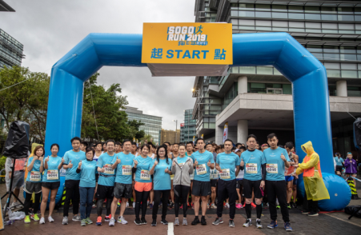
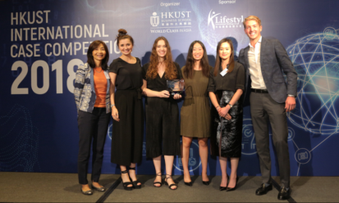
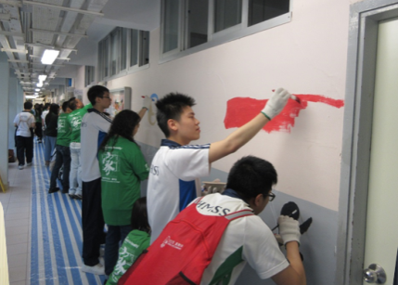
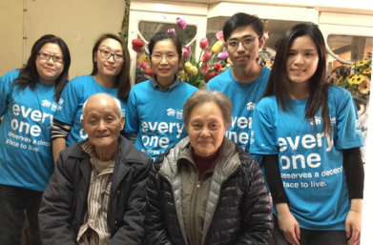
Community Involvement
Work regularly with various charitable organizations for volunteering works
5th SOGO Charity Run
Sponsor HKUST “International Case Competition 2018”
Elderly Home Visits
School Wall Painting
Donating food to food bank

Slide 9
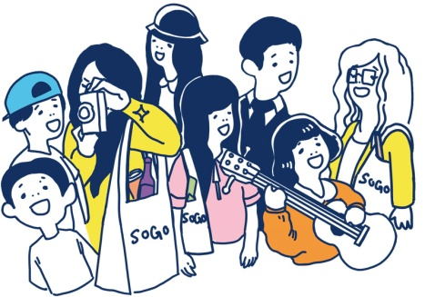
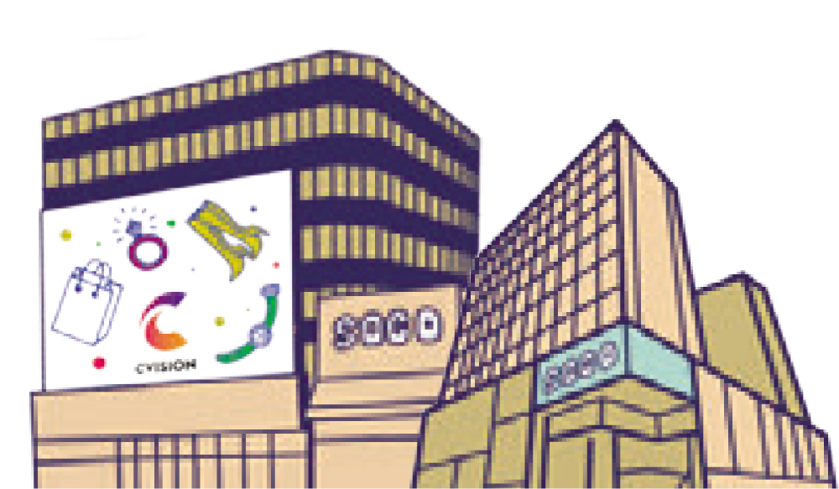
Future Plan and Strategies
Kai Tai Project
To be completed in 2022
Capture the rising purchasing power of East Kowloon area
Create another landmark and further enhance our market position
Continuous customer enhancement by various channels, such as SOGO Rewards Apps to monitor the needs of our customers and tailor make our goods and services
Provide more convenient shopping experience to our customers by optimizing the online store channel
Open to synergistic business opportunities

Slide 10
Q&A
9

